Slide 1

A Comprehensive Anti-Theft Vehicle Protection Framework Using Embedded Electronics and Python
KKR & KSR INSTITUE OF TECHNOLOGY & SCIENCES
Approved by AICTE, New Delhi, Affiliated to JNTUK, Kakinada Accrediated by NAAC with "A' Graded Vinjanampadu, Guntur, Andhra Pradesh-522017 India
DEPARTMENT OF ELECTRONICS AND COMMUNICATION ENGINEERING
Title of the Project
GUIDE NAME
K. MALLIKARJUNA RAO M. Tech, (PhD)
Assistant Professor , ECE
BATCH -14 TEAM MEMBERS:
Pinapala Sai Pavan (21JR1A04F9)
Loya Ravi Teja (21JR1A04G7)
Vennapusa Chinna Lingareddy(21JR1A04J0)
Tatanaboina Johny (21JR1A04I2)

Slide 2
Contents
Abstract
Introduction
Existing System Theory
Existing System Block Diagram
Proposed System Theory
Proposed System Block Diagram
Requirements
Proposed System Circuit Diagram
Advantages
Disadvantages
Applications
Conclusion
Project Output Images
Project Paper Publication
References
Literature Survey

Slide 3
Abstract
Advanced Theft Detection: Utilizes fingerprint and vibration sensors to detect unauthorized access, with a camera module capturing intruder images for evidence.
Immediate Alerts and Deterrents: Sends real-time SMS alerts with GPS location via GSM, triggers a buzzer, and delivers a mild shock using a boost converter to deter intruders.
Secure Access Control: Includes remote access for authorized users and a relay-controlled engine system, ensuring the vehicle operates only with proper authorization.
Integrated Development:ESP32 module, programmed using Embedded C and Python, for a reliable and intelligent anti-theft solution.
AIM: To create a vehicle security system with vibration sensing, Biometric access, alerts, and remote controls to prevent theft.

Slide 4
Introduction
Overview: Vehicle theft poses a serious challenge, requiring advanced systems to enhance security and prevent unauthorized access.
Objective: This project introduces a robust anti-theft system using ESP32 module with integrated sensors and alerts.
Key Features: Includes fingerprint and vibration sensors, a camera module for intruder detection, GPS-based SMS alerts, and deterrents like a buzzer and shock mechanism.
Convenience: Offers remote access for authorized users and engine control via a relay module, ensuring security and ease of use.

Slide 5
Existing System Theory
RFID-Based Authorization: The system employs RFID technology to authenticate users, ensuring that only authorized personnel can access or operate the vehicle, enhancing security and preventing unauthorized usage.
Vibration Sensor Tampering Detection: Vibration sensors continuously monitor for unusual shocks or movements, such as forced entry or tampering attempts, triggering alerts to indicate potential threats or unauthorized activities.
Arduinoc and GSM for Alerts: The Arduino Uno microcontroller processes input from the RFID module and vibration sensors. Upon detecting a tampering event, it activates a buzzer for immediate local alerts and sends SMS notifications via the GSM module for real-time remote monitoring and quick response.

Slide 6
Existing System Block Diagram
Power Supply
RFID
Buzzer
Arduino Uno
Vibration Sensors
GSM
SMS

Slide 7
Proposed System Theory
Advanced Theft Detection: Utilizes fingerprint and vibration sensors to detect unauthorized access, with a camera module capturing intruder images for evidence.
Immediate Alerts and Deterrents: Sends real-time SMS alerts with GPS location via GSM, triggers a buzzer, and delivers a mild shock using a boost converter to deter intruders.
Secure Access Control: Includes remote access for authorized users and a relay-controlled engine system, ensuring the vehicle operates only with proper authorization.
Integrated Development: ESP32 module, programmed using Embedded C and Python, for a reliable and intelligent anti-theft solution.

Slide 8
Proposed System Block Diagram
Power Supply
GPS
Storage
Fingerprint Sensor
ESP-32
Email
Vibration Sensor
Camera
GSM
Phone
Boost Converter Module
DC Motor
Buzzer
Relay

Slide 9
Requirements
Hardware Requirements
ESP-32
Power Supply
Fingerprint Sensor
Vibration Sensors
GPS
Camera
GSM Module
Relay Module
Boost Converter Module
DC Motor
Phone
Buzzer
Software Requirements
Embedded C
Python Programming Language
GSM Communication
Input voltage 3.3 Volts

Slide 10
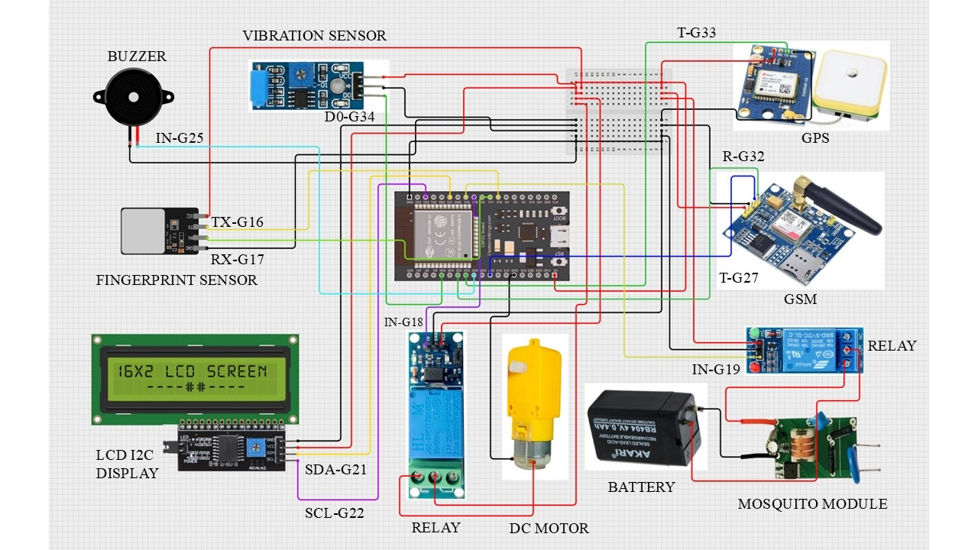
Circuit Diagram

Slide 11
Advantages
Enhanced Security: Multi-layered protection with shock sensors, facial recognition, and engine-seizing.
Real-Time Alerts: Instant email notifications for quick response.
Remote Control: Grant access securely via SMS through a GSM module.
Proactive: Detects and prevents tampering or unauthorized access early.

Slide 12
Disadvantages
Complex Installation: Initial setup may require technical expertise and time.
Power Dependency: The system relies on a consistent power supply for continuous operation.

Slide 13
Applications
Personal Vehicle Security: Protects private vehicles from theft and unauthorized access.
Public Transport: Enhances security for buses and taxis against theft or unauthorized use.
Luxury and High-Value Vehicles: Offers advanced protection for expensive or rare vehicles.
Government and Military Vehicles: Provides additional security for sensitive or high-priority transport.
Rental Services: Monitors and protects rented vehicles, ensuring access is granted only to authorized users.

Slide 14
Conclusion
The Vehicle Theft Detection and Protection System provides a robust and efficient solution to combat vehicle theft. By integrating ESP32 with advanced sensors, a camera module, and real-time alert mechanisms, the system ensures comprehensive security. Features like remote access, GPS-based notifications, and controlled engine activation enhance user convenience while maintaining stringent safety protocols. This innovative approach effectively addresses modern security challenges, offering a reliable and user-friendly solution for vehicle owners.

Slide 15
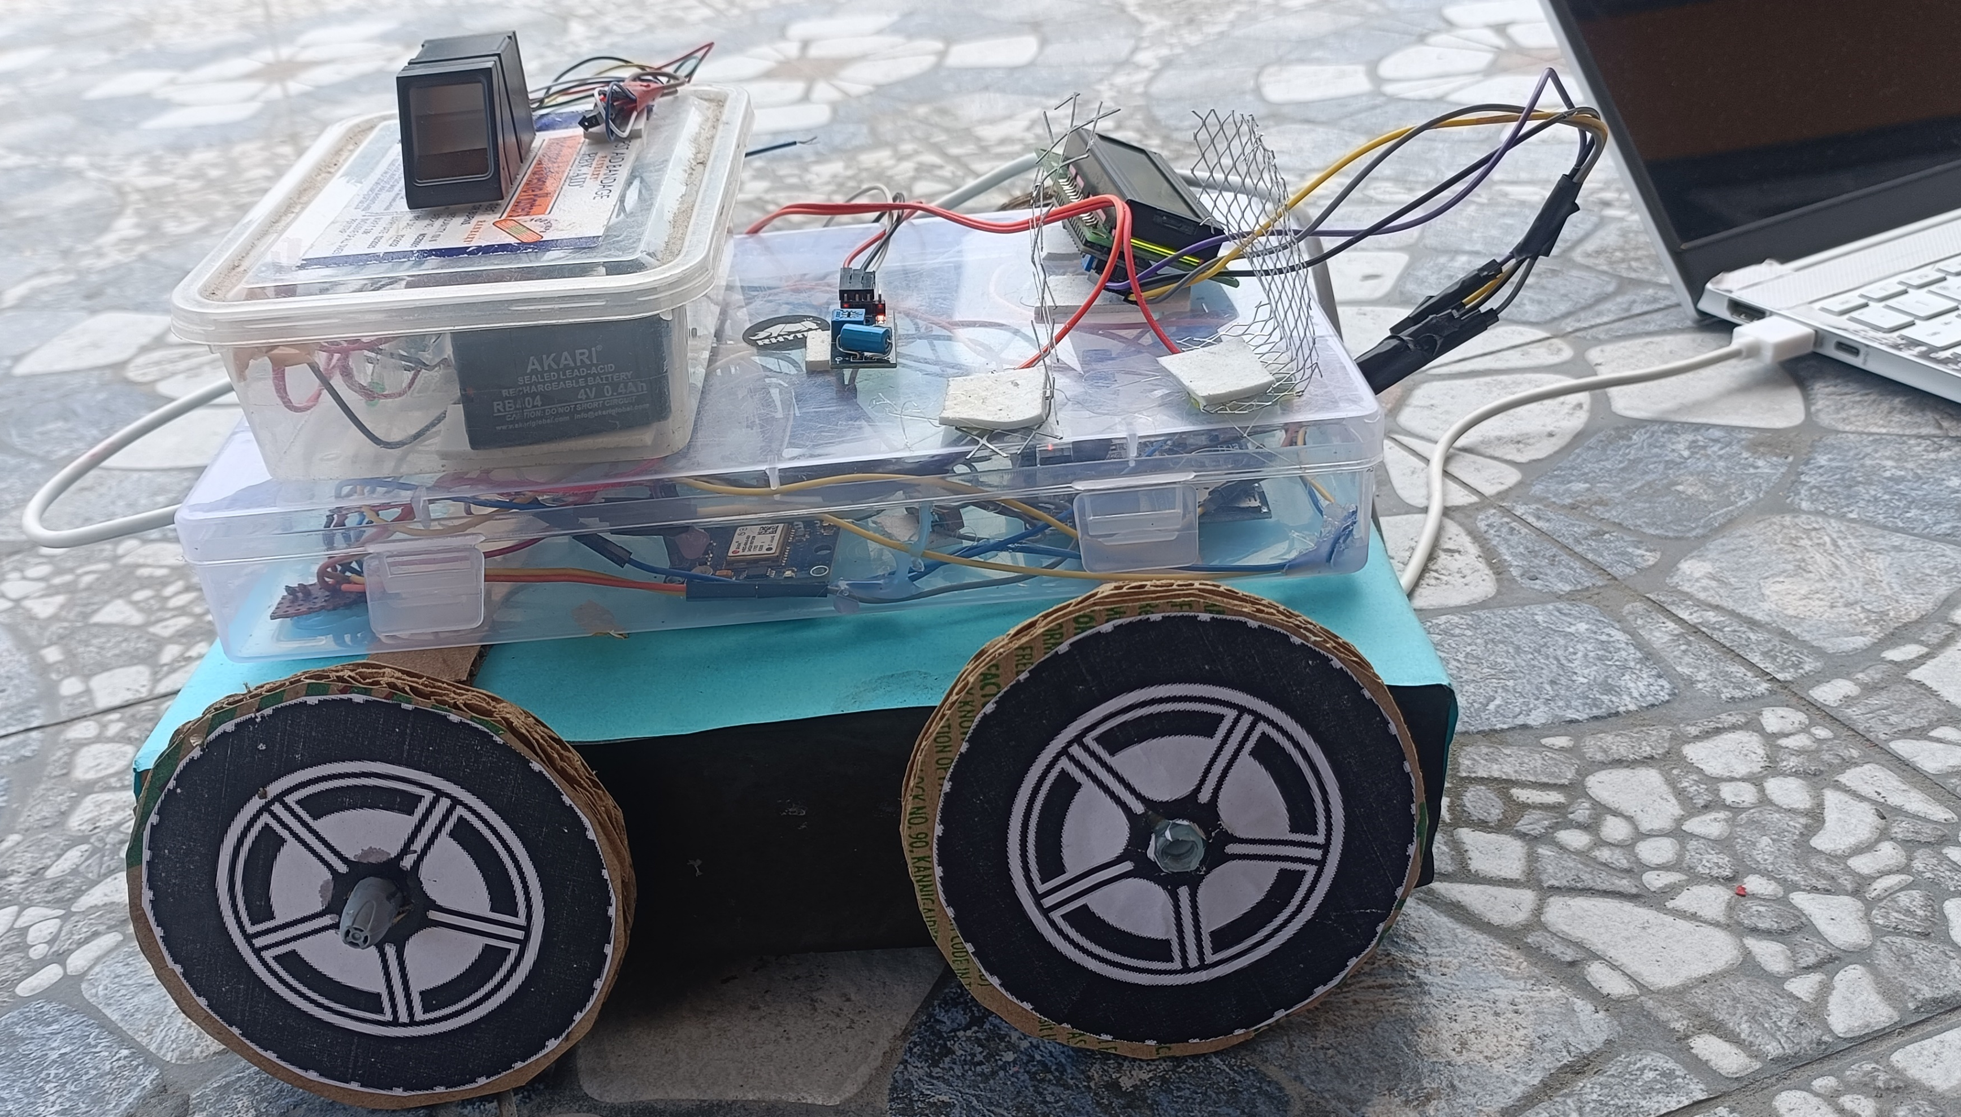
Project Output Images
Final Prototype Image

Slide 16
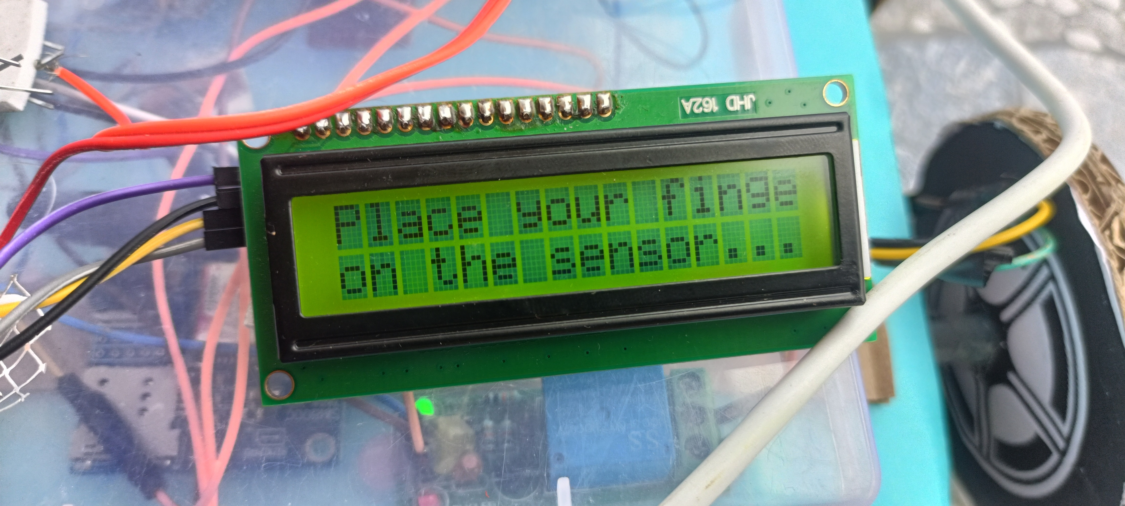
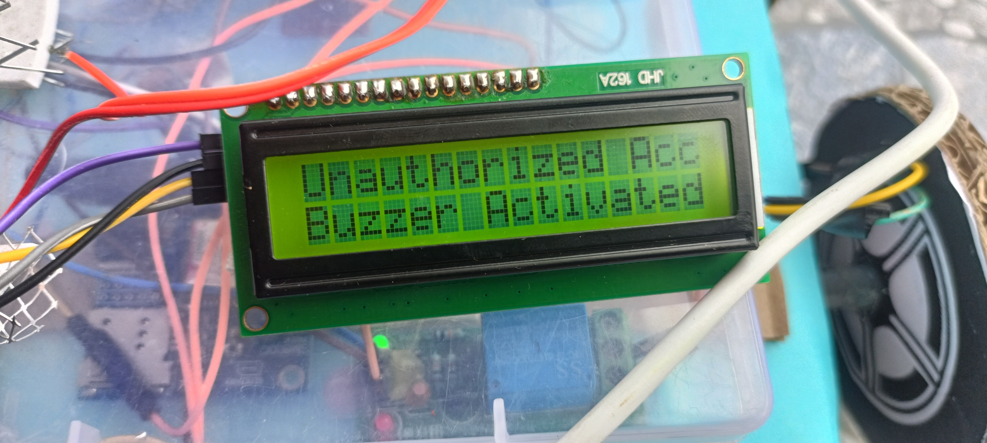
Fingerprint Sensor is ready to access the input
Unauthorized Access detected at the fingerprint input and the buzzer is activated

Slide 17
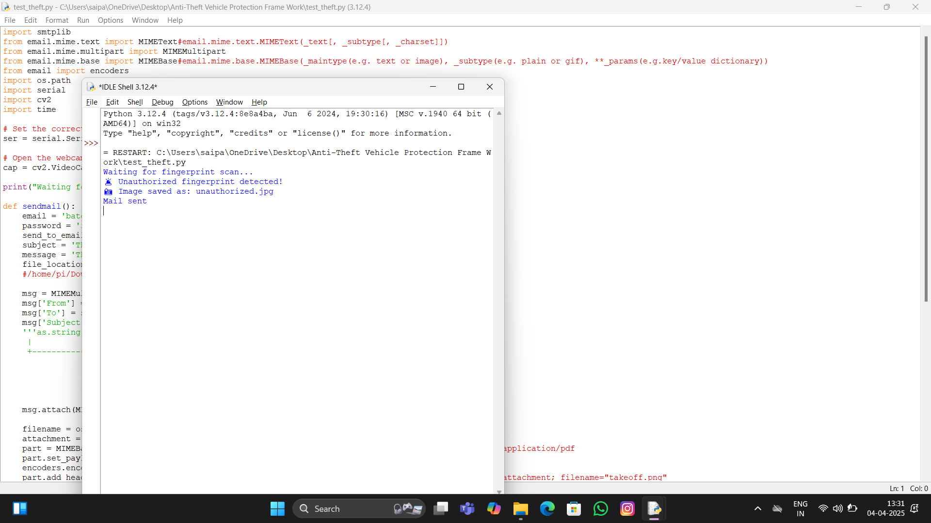
When Unauthorized is detected the Camera sensor Captures the Image of the thief and sends the image through Mail and also stores in the memory/storage

Slide 18

When Vibration detects any Vibrations it Immediately Sends Gps location and alert message through SMS Via GSM module

Slide 19
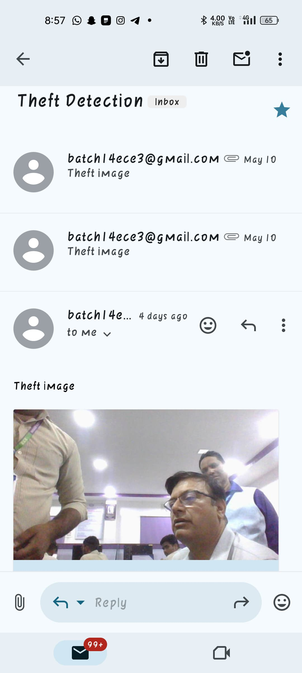
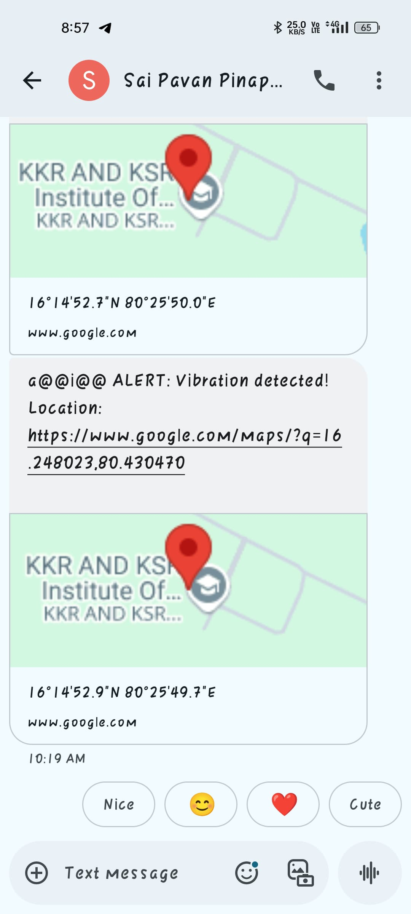
Unauthorized Person Photo received through Mail
Alert Message and GPS Location received

Slide 20
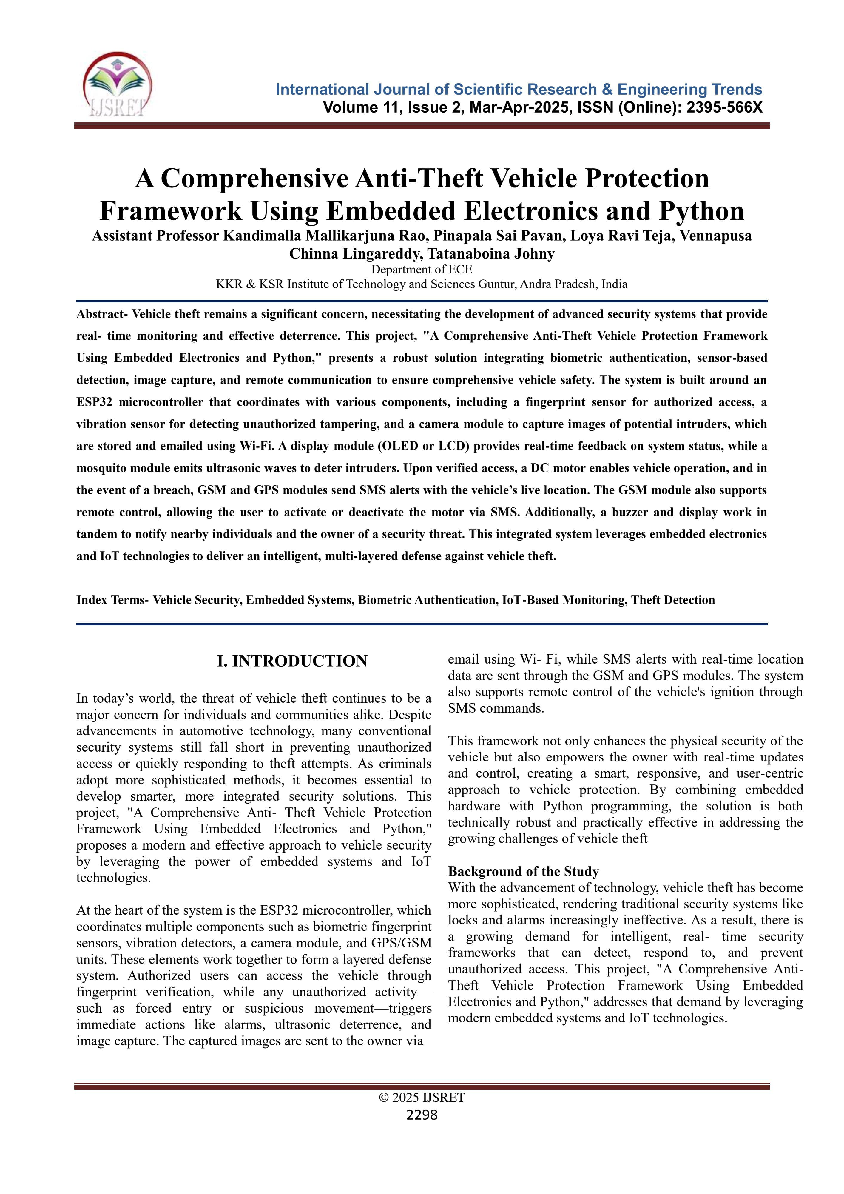
Project Paper Publication
DOI: https://doi.org/10.61137/ijsret.vol.11.issue2.427

Slide 21
References
https://ieeexplore.ieee.org/document/8728460
https://ieeexplore.ieee.org/document/9052246
https://ieeexplore.ieee.org/document/9915691

Slide 22
Literature Survey
S.No | Title | Year | Contributions | Disadvantages
1 | Hybrid GPS-GSM Localization of Automobile Tracking System | 2012 | Enhances GPS location accuracy using a Kalman filter and displays tracking data on Google Earth. | No authentication or camera system; lacks remote vehicle control.
2 | An Authentication Protocol Based on Combined RFID-Biometric System | 2012 | Proposes a secure protocol combining RFID and biometric data with formal security validation. | No hardware implementation; does not handle real-time tracking or alerts.
3 | Biometric Blockchain: A Secure Solution for Intelligent Vehicle Data Sharing | 2019 | Integrates biometrics with blockchain for secure and tamper-proof vehicle data sharing. | Theoretical design only; lacks theft detection and embedded system integration.
4 | Advanced Vehicle Security System Using Biometric Visuals | 2024 | Uses facial recognition and Raspberry Pi for vehicle access control. | No tracking or GSM functionality; vulnerable to spoofing without liveness detection.
5 | Design of a Communication System for Identification of Vehicle Plates | 2025 | Uses ESP32-CAM and LoRa for low-power wireless transmission of license plate images. | Focuses only on plate recognition; no theft prevention or user authentication.

Slide 23


